Slide 1
Unit 1—Lesson 1:
Introduction to Swift and Playgrounds
Notes:
Say
Let’s get started.
In this lesson, you'll learn about the origin of Swift and some of its basic syntax.

Slide 2

A little history
Notes:
Say
Swift was introduced at WWDC 2014 as a modern language for writing apps for iOS and macOS.
It replaces Objective-C as the primary language for iOS and macOS.
It’s easier than other languages to learn, read, write, and maintain applications.

Slide 3
A modern language
SAFE
FAST
EXPRESSIVE
Notes:
Say
Swift is a modern language—it’s safe, fast, and expressive.
Do
Explain the meaning of “safe,” “fast,” and “expressive.”
Explain the key features:
Clean syntax
Optionals
Type inference
Type safety
Automatic Reference Counting (ARC) for memory management
Tuples and multiple return values
Generics
Fast and concise iteration over collections
Structs that support methods, extensions, and protocols
Map, filter, reduce, and other functional programming patterns
Powerful error handling

Slide 4
A safe language
Explicit object “types”
Type inference
Optionals
Error handling

Slide 5
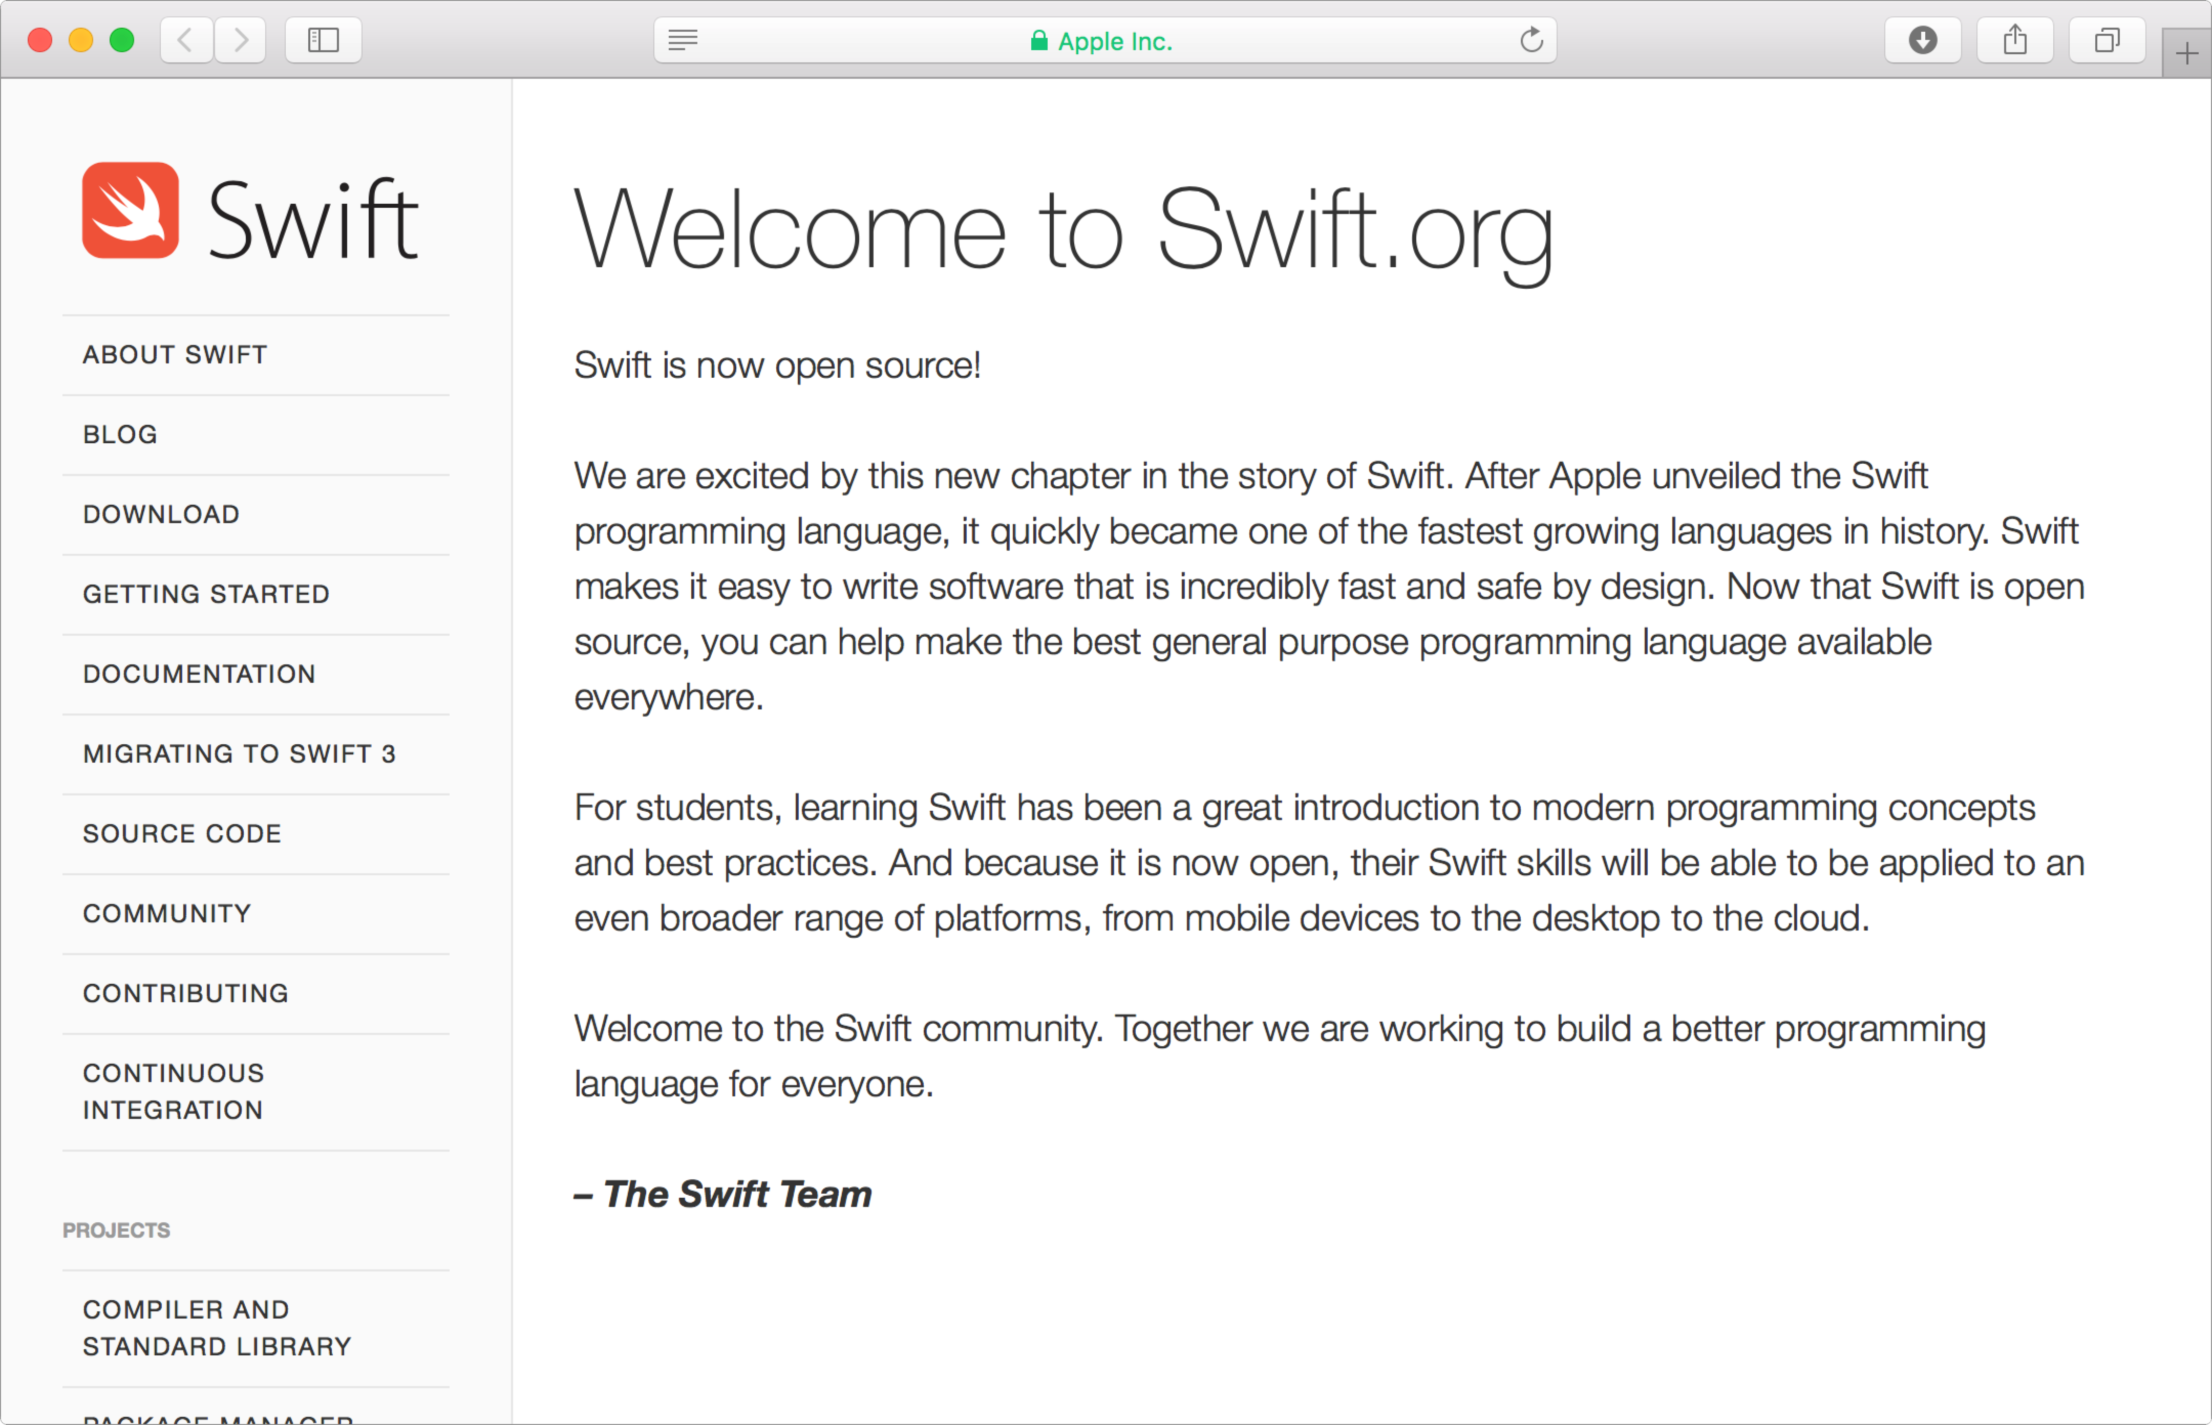
Open Source
Notes:
Say
Swift was released as open source in December 2015.
“Open source” means that there’s community input and support, it’s evolving and improving, and there’s support for more platforms over time.
For more information, go to Swift.org.

Slide 6

Hello, world
print("Hello, world!")
main.swift
Notes:
Do
Describe the Swift file format (plain text, .swift file extension, one or more statements, and so on).
Explain that there’s one file for code and definitions.
Demonstrate how the simplest app to write is “Hello, world!”

Slide 7
Hello, world
Open Terminal
Type swift and press Enter
Type print("Hello, world!") and press Return
Type quit and press Return
Quit Terminal
Notes:
Say
Swift comes with the REPL (Read, Eval, Print Loop) tool to evaluate simple commands.
Do
Quickly demonstrate creating “Hello, world!” in Swift in Terminal. Students can follow along.

Slide 8
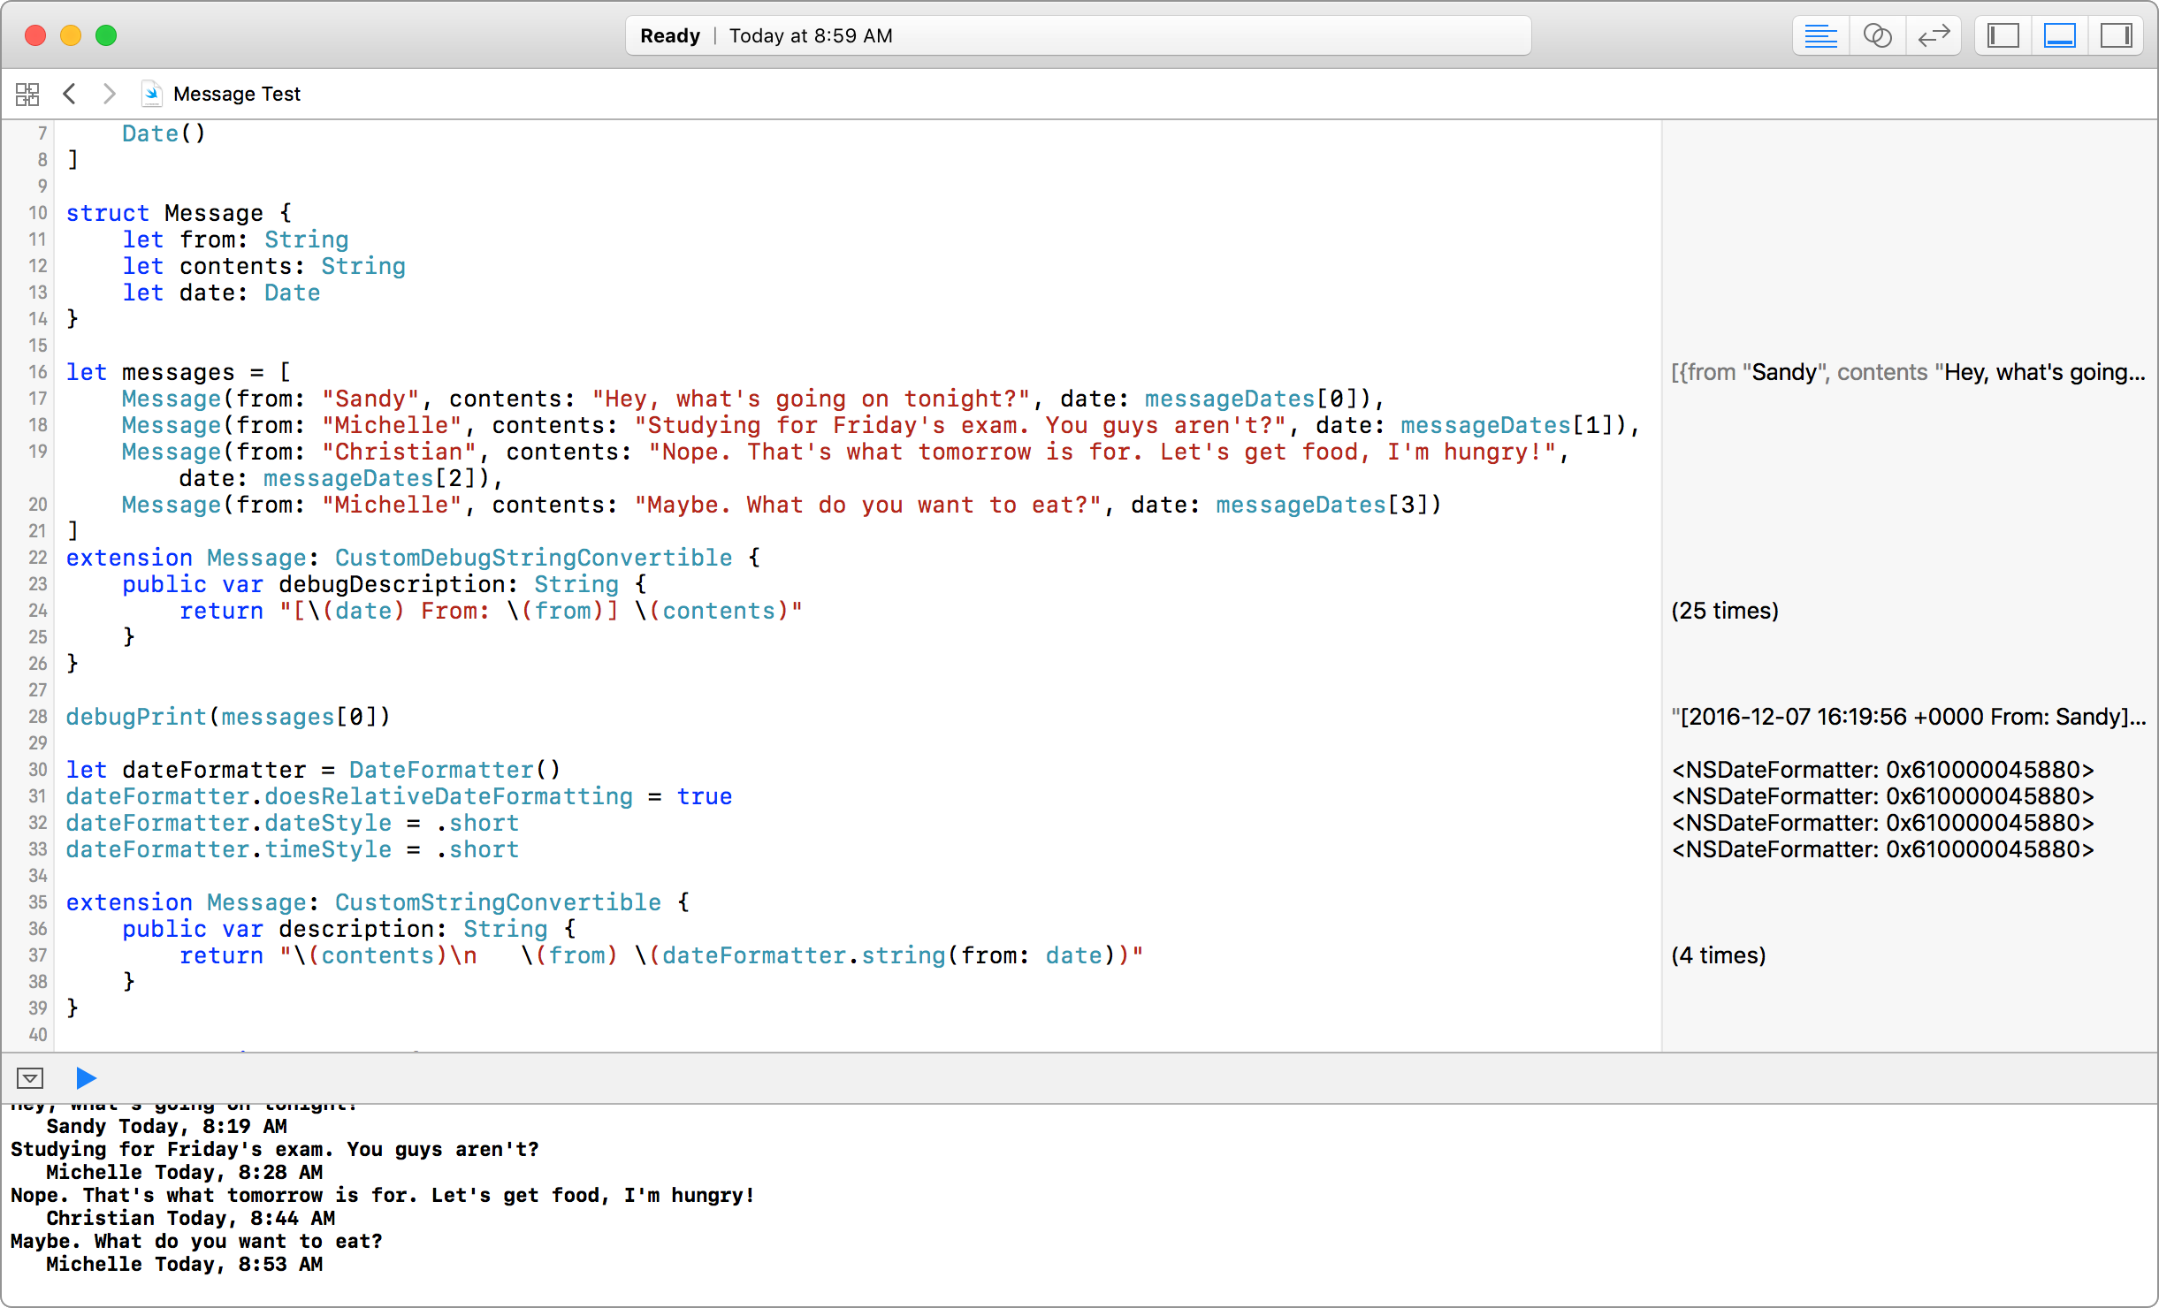
Playgrounds
Notes:
Do
Open PlaygroundDemo and describe the playground environment.
Show the lower-left run button: Click and hold and show "run automatically" and "run manually.”
Show the lower-left show/hide debug area.
Show the right column output.
Say
You can hover over output to see the eye icon inspector.
[Click the eye for a popover with the output.]
You can hover over output to see the square “Show Output Inline” inspector.
Do
Show the attributes inspector “Show Timeline Checkbox.”
Show moving the timeline.

Slide 9
Hello, world
Open Xcode
Choose File > New > Playground
Name the playground “Hello, world!” and choose iOS for the platform
Click Next and save the playground
Add print("Hello, world!")
Replace "Hello, world!" with str
Notes:
Do
Present this as a group activity, with participants following along on their own computers.
As you go through this procedure with the participants, discuss the autocomplete feature while you enter the print statement.

Slide 10
Unit 1—Lesson 1
Open and complete the exercises in Lab - Introduction.playground
Notes:
Do
Explain the two commenting methods.

Slide 11
Notes:
L550025A-en_WW App Development with Swift © 2017 Apple Inc. This work is licensed by Apple Inc. under the Creative Commons Attribution-NonCommercial-ShareAlike 4.0 International license (https://creativecommons.org/licenses/by-nc-sa/4.0/legalcode).

